Slide 2
GE2025- PROFESSIONAL ETHICS IN ENGINEERING
Reference:
Mike Martin and Roland Schinzinger, “Ethics in Engineering”, McGraw Hill, New York (2005).
Notes:
2

Slide 3
UNIT I
Engineering Ethics

Slide 4
Unit I
Senses of Engineering Ethics
Variety of moral issues
Types of inquiry
Moral dilemmas
Moral Autonomy
Kohlberg’s theory & Gilligan’s theory
Consensus and Controversy
Professions and Professionalism
Professional Ideals and Virtues and Uses of Ethical Theories.
Notes:
4
What is Engineering Ethics?
The study of moral issues and decisions confronting individuals engaged in engineering.
The study of related questions about the moral ideas, character, policies, and relationships of people and organizations invoved in technical activity. Ethos (Greek) = mores (Latin) meaning “customs”

Slide 5
The Goal
The course will develop a framework on which
professional and ethical issues can be analyzed,
Build up an awareness of various views of ethical issues as well as professionals ethical rights and responsibilities.
Notes:
5

Slide 6
ENGINEERING ETHICS
The study of moral issues and decisions confronting individuals and organizations involved in engineering and
The study of related questions about moral ideals, character, policies and relationships of people and organizations involved in technological activity.
{* Confronting – Challenging
* ideals - Principles}

Slide 7
TRAINING IN PREVENTIVE ETHICS
Stimulating the moral imagination
Recognizing ethical issues
Developing analytical skills
Eliciting a sense of responsibility
Tolerating disagreement and ambiguity

Slide 8
IMPEDIMENTS TO RESPONSIBILITY
Self-interest.
Fear.
Self-deception.
Ignorance.
Egocentric tendencies.
Microscopic vision.
Groupthink.

Slide 9
SENSES OF EXPRESSION OF ENGINEERING ETHICS
Ethics is an activity and area of inquiry. It is the activity of understanding moral values, resolving moral issues and the area of study resulting from that activity.
When we speak of ethical problems, issues and controversies, we mean to distinguish them from non moral problems.
Ethics is used to refer to the particular set of beliefs, attitudes and habits that a person or group displays concerning moralities.
Ethics and its grammatical variants can be used as synonyms for „morally correct‟.

Slide 10
WHAT IS MORALITY?
The term ‘morality’ concerns with
what ought or ought not to be done in a given situation?
what is right or wrong in handling it?
what is good or bad about the persons, policies and principles involved in it?
If an action is said to be morally right it should had some moral reasons.

Slide 11
MORAL REASONS
Moral reasons include
Respecting others and ourselves,
Respecting the rights of others,
Keeping promises,
Avoiding unnecessary problems to others
Avoiding cheating and dishonesty,
Showing gratitude to others and encourage them to work

Slide 12
VARIETIES or APPROACHES OF MORAL ISSUES
MICRO-ETHICS:
This approach stresses more about some typical and everyday problems which play an important role in the field of engineering and in the profession of an engineer
MACRO-ETHICS:
This approach deals with all the social problems which are unknown and suddenly burst out on a regional or national level

Slide 13
TYPES OF INQUIRY
Inquiry means an investigation:-
Engineering ethics involves investigations into values, meaning and facts.
Normative Inquiries
Conceptual Inquiries
Factual or Descriptive Inquiries

Slide 14
NORMATIVE INQUIRY
These are about „what ought to be‟ and “what is good”. These questions identify and also justify the morally desirable norms or standards.
Some of the questions are:
A. How far engineers are obligated to protect public safety in given situations?
B. When should engineers start whistle blowing on dangerous practices of their employers?
C. Whose values are primary in taking a moral decision, employee, public or govt?
D. Why are engineers obligated to protect public safety?
E. When is govt justified in interfering on such issues and why?

Slide 15
CONCEPTUAL INQUIRY:
These are meant for describing the meaning of concepts, principles, and issues related to Engineering Ethics.
Examples are:
What is SAFETY and how is it related to RISK
Protect the safety, health and welfare of public-What does this statement mean?
What is a bribe?
What is a profession and who are professionals?

Slide 16
FACTUAL (DESCRIPTIVE) INQUIRIES
These help to provide facts for understanding and finding solutions to value based issues.
These are inquiries used to uncover information using scientific techniques.
These inquiries get to information about business realities, history of engineering profession, procedures used in assessment of risks and engineers psychology.

Slide 17
MORAL DILEMMMA
Why study engineering ethics?
Engineering ethics is not only teaching moral behavior in knowing about immoral in a set of beliefs, but also increasing the ability of engineers and other professionals to face boldly with the moral problems arising from technological advancements, changes and other related activities.

Slide 18
MORAL DILEMMMA
Dilemmas are certain kind of situations in which a difficult choice has to be made.
Moral dilemmas have two or more foldings - moral obligations, duties, rights, goods or ideals come into disagreement with each other.
One moral principle can have two or more conflicting applications for a particular given situation.

Slide 19
MORAL DILEMMMA
There are three types of complexities.
VAGUENESS: (தெளிவற்ற):
This complexity arises due to the fact that it is not clear to individuals as to which moral considerations or principles apply to their situation.
CONFLICTING REASONS (முரண்பாடான காரணங்கள்):
Even when it is perfectly clear as to which moral principle is applicable to one’s situation, there could develop a situation where in two or more clearly applicable moral principles come into conflict.
DISAGREEMENT(கருத்து வேறுபாடு):
Individuals and groups may disagree how to interpret, apply and balance moral reasons in particular situations.

Slide 20
STEPS / PROCEDURES IN FACING MORAL DILEMMAS
Identifying the relevant moral factors and reasons: i.e. Finding solutions for (i) the conflicting responsibilities (ii) the competing rights and (iii) the clashing ideals involved.
Collecting and gathering all the available facts which are relevant to the moral factors while resolving.
Ranking the moral considerations or principles on the basis of importance as applicable to the situation.
Considering alternative courses of action for resolving the problems and tracing the full implications of each. i.e. conducting factual inquiries.
Having talked with the colleagues, friend about the problem getting their suggestions and alternative ideas on resolving that dilemma.
Arriving at a careful and reasonable judgment or solution by taking into consideration of all important moral factors and reasons on the basis of the facts or truths.

Slide 21
MORAL AUTONOMY
Autonomy means self-governing or self-determining i.e act independently.
Moral autonomy is concerned with the independent attitude of a person related to ethical issues.
It helps to improve the self-determination among the individuals.
Autonomous individuals think for themselves and do not assume that customs are always right.
They seek to reason and live by general principles.
Their motivation is to do what is morally reasonable for its own sake, maintaining integrity, self-respect, and respect for others

Slide 22
SKILLS FOR IMPROVING MORAL AUTONOMY
The engineers must have the ability to distinguish and relate these moral problems with the problems of law, economics, religions principles etc.
They must possess(have) the skills of understanding, clarifying and assessing the arguments which are against the moral issues.
They must have the ability to suggest the solutions to moral issues, on the basis of facts. These suggestions must be consistent and must include all the aspects of the problem.
They must have the imaginative skill to view the problems from all view points and also be able to suggest a proper alternative solution.

Slide 23
SKILLS FOR IMPROVING MORAL AUTONOMY
They must be able to tolerate while giving moral judgments and decisions which may cause trouble.( i.e. they have to understand the difficulties in making moral decisions.)
They must have adequate knowledge and understanding about the use of ethical language so as to defend or support their views with others.
They must have some better knowledge in understanding the importance of suggestions and better solutions while resolving moral problems and also about the importance of tolerance on some critical situations.
They must understand the importance of maintaining the moral honesty i.e. the personal convictions and beliefs and individual‟ s professional life must be integrated. They must have this skill of doing so.

Slide 24
KOHLBERG’S THEORY
Moral Autonomy is based on the psychology of moral development.
The first psychological theory was developed by Jean Piaget
On the basis of Piaget’s theory, Lawrence kohlberg developed three main levels of moral development
Which is based on the kinds of reasoning and motivation adopted by individuals with regard to moral questions.

Slide 25


Slide 26
STAGES OF MORAL DEVELOPMENT
Pre-conventional Level:
It is nothing but self-centered attitude.
In this level, right conduct is very essential for an individual which directly benefits him
According to this level, individuals are motivated by their willingness to avoid punishment, or by their desire to satisfy their own needs
This level is related to the moral development of children and some adults who never want to go beyond a certain limit.

Slide 27
STAGES OF MORAL DEVELOPMENT
Conventional Level:
As per this level the rules and norms of one’s family or group or society has been accepted as the final standard of morality.
When individuals are under this level, always want to satisfy others and also to meet the expectations of the society and not their self interest.
No adult tries to go beyond this level.

Slide 28
STAGES OF MORAL DEVELOPMENT
Post- Conventional Level:
This level is said to be attained when an individual recognizes the right and the wrong on the basis of a set of principles which governing rights and the general good which are not based on self- interest or social conventions.
These individuals are called “autonomous”, because they only think for themselves and also they do not agree that customs are always correct.
They want to live by general principles which are universally applied to all people.

Slide 29
Lawrence Kohlberg
Kohlberg‟s theory of moral development is very much related to the goals of studying ethics at college level
Moral responsibility comes out of the foundation of early moral training given by an individual’s parents and culture.
As per Kohlberg’s view only few people would reach the post conventional level

Slide 30
Kohlberg’s Theory of Moral Development
Each level is based on the degree to which a person conforms to conventional standards of society
Each level has two stages that represent different degrees of sophistication in moral reasoning.
Notes:
30

Slide 31
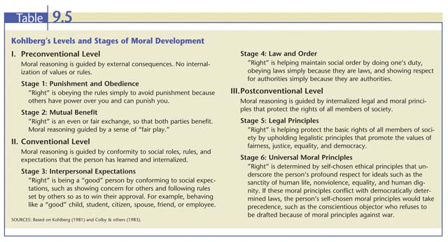

Slide 32
Criticisms of Kohlberg’s theory
Research has not supported Kohlberg’s belief that the development of abstract thinking in adolescence invariably leads people to the formation of idealistic moral principles
Some cross-cultural psychologists argue that Kohlberg’s stories and scoring system reflect a Western emphasis on individual rights, harm, and justice that is not shared in many cultures.
Kohlberg’s early research was conducted entirely with male subjects, yet it became the basis for a theory applied to both males and females.

Slide 33

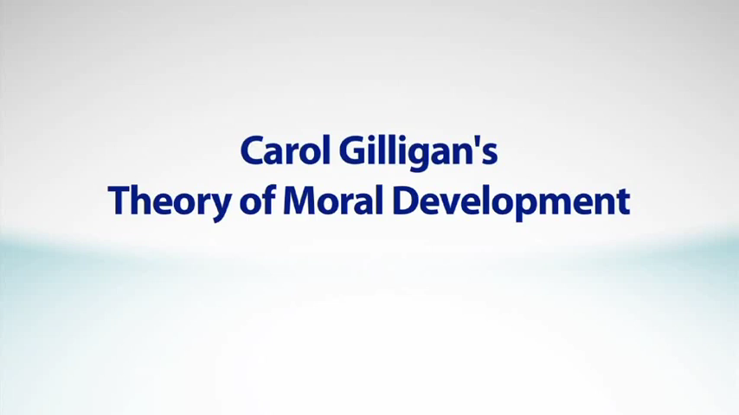

Slide 34
GILLIGAN’S THEORY
Pre-conventional Level
This is the same as Kohlberg’s first level in that the person is preoccupied with self centered reasoning, caring for the needs and desires of self.
Conventional
Here the thinking is opposite in that, one is preoccupied with not hurting others and a willingness to sacrifice one’s own interests in order to help or nurture others (or retain friendship).
Post-conventional Level
Achieved through context-oriented reasoning, rather than by applying abstract rules ranked in a hierarchy of importance. Here the individual becomes able to strike a reasoned balance between caring about other people and pursuing one’s own self-interest while exercising one’s rights.

Slide 35
Carol Gilligan’s Model
Feels Kohlberg’s model is based on an ethic of individual rights and justice, which is a more common perspective for males
Gilligan’s model of women’s moral development is based on an ethic of care and responsibility.
However, when subjects are carefully matched, there do not seem to be systematic gender differences in moral reasoning

Slide 36
CONSENSUS AND CONTROVERSY
Consensus – Agreement
Controversy – Disagreement

Slide 37
CONTROVERSY
All individuals will not arrive at same verdict during their exercising their moral autonomy.
Aristotle noted long ago that morality is not as precise and clear-cut as arithmetic.
Aim of teaching engineering ethics is not to get unanimous conformity of outlook by indoctrination, authoritarian and dogmatic teaching, to improve promotion of tolerance in the exercise of moral autonomy hypnotism or any other technique but.
[* unanimous – Common * verdict- decision * indoctrination – instruction * authoritarian, dogmatic - strict]

Slide 38
CONSENSUS
The conductor of a music orchestra has authority over the musicians and his authority is respected by them by consensus as otherwise the music performance will suffer. Hence the authority and autonomy are compatible.
On the other hand, tension arises between the needs for autonomy and the need for concerns about authority. The difference between the two should be discussed openly to resolve the issue to the common good.

Slide 39
Membership Criteria
Complete Bachelors degree
Performing work commonly recognized as what engineers do
Being officially and licensed as a PE.
Acting in morally responsive ways while practicing engineers

Slide 40
Differing views on Professionals
“Only consulting engineers who are basically independent and have freedom from coercion can be called as professionals.” -Robert L.Whitelaw
“Professionals have to meet the expectations of clients and employers. Professional restraints are to be imposed by only laws and government regulations and not by personal conscience.” -Samuel Florman
* Coercion – Pressure
* Restraints- limits

Slide 41
Characteristics of Professions
Profession- meet the following criteria
Knowledge
Organization
Public Good
Who is Professional?
Knowledge:- skills cant be mechanized
Organization: IEEE, ASME
Public Good: to protect public health safety welfare

Slide 42
Professionalism
Qualities, competencies and Skills of professionals

Slide 43
MOTIVES FOR PROFESSIONALISM
A desire for interesting and challenging work and the pleasure in the act of changing the world.
The joy of creative efforts. Where a scientist’s interest is in discovering new technology, engineers interest is derived from creatively solving practical problems.
The engineer shares the scientist’s job in understanding the laws and riddles of the universe.
The sheer magnitude of the nature – oceans, rivers, mountains and prairies – leads engineers to build engineering marvels like ships, bridges, tunnels, etc., which appeal to human passion.
*Sheer - pure

Slide 44
MODELS OF PROFESSIONAL ENGINEERS
SAVIOR: The representative engineer is a savior who will redeem society from poverty, inefficiency, waste and the drudgery of manual labor.
GUARDIAN: Engineers know, the directions in which and pace at which, technology should develop.
BUREAUCRATIC SERVANT: The engineer as the loyal organization person uses special skills to solve problems.
SOCIAL SERVANT: Engineers, in co-operation with management, have the task of receiving society’s directives and satisfying society’s desires.
Social ENABLER AND CATALYST
GAME PLAYER
* Savior – Rescuer

Slide 45
Professional Ethics & Virtes
Virtue means Good character of an individual
It is defined as moral distinction of goodness
It can be defined as excellence of moral behavior

Slide 46
The Four Main Virtues
Prudence (mind) (விவேகம்): to think about a moral problem clearly and completely
Temperance (emotions) (தன்னடக்கம்): control attraction to positive emotions
Fortitude (emotions) (மனோபலம்): control aversion for negative emotions
Justice (will) (நீதி): choose according to truth and fairness.
Notes:
46

Slide 47

Virtue Ethics
Focuses on the type of person we should strive to be
Actions which reflect good character traits (virtues) are inherently right
Actions which reflect bad character traits (vices) are inherently wrong
Virtue ethics are tied more to individual behavior than to that of an organization (e.g. business, government)
Vices
Bad character
Wrong actions

Slide 48
Professional Responsibility
Virtues Defining Professional Responsibility.
Professional responsibility means being morally responsible as a professional
Classification of virtues:
Self Directional Virtues
Public Spirited Virtues
Teamwork Virtues
Proficiency Virtues

Slide 49
Professional Responsibility
1. SELF DIRECTION VIRTUES:
Fundamental virtues in exercising our moral autonomy and responsibility. e.g. self understanding, humility, good moral judgment, courage, self discipline, perseverance, commitments, self-respect and dignity
2. PUBLIC SPIRITED VIRTUES:
Focusing on the benefit of the clients and society.
3 important public spirited virtues
Justice, Sense of community, generosity
3. TEAMWORK VIRTUES:
Enables professionals to work successfully with others. E.g. collegiality, cooperativeness, the ability to communicate, respect for authority, loyalty to employers and leadership qualities.
4. PROFICIENCY VIRTUES: (intellectual Virtue)
Mastery of one’s craft that characterize good engineering practice e.g. competence, diligence, creativity, self-renewal through continuous education
(mastery over the profession)

Slide 50
Types of Ethical Theories
Theory | Basic Concept
Virtue Ethics Theory | Virtues and Vices
Right Ethics Theory | Human Rights
Duty Ethics Theory | Duties to respect persons
Utilitarianism theory | Most good for the most people

Slide 51
Aristotle’s theory of the “Golden Mean”
In this theory virtue of wisdom or good judgement is highly essential for accomplishing the rational activities successfully
As per this theory, virtues to find the ‘golden mean’ between the extremes of excess and deficiency

Slide 52
Example
Courage is ‘golden mean’ between the two extreme moral grounds foolhardiness(the excess of rashness) and cowardice(the deficiency of self control)
(one should be courageous but should not go to extreme of being violent)
The skills in avoiding offences and confidentiality

Slide 53
Macintyre’s Theory of virtue
Alasdair Macintyre, a contemporary ethicst, related virtues with the social practices ie., cooperative activities that are aimed at achieving public goods.
According to him, any profession should develop for the sake of public goods
He calls public goods as internal goods

Slide 54
Example
The primary internal good of medicine is promotion of health
Law is social justice
Engineering is safety, health and welfare of public

Slide 55
Uses Of Ethical Theories
Ethical theories aid in identifying the moral considerations or reasons that constitute a dilemma.
They provide a precise sense of what kinds of information are relevant to solving moral development.
They sometimes, offer ways to rank the relevant moral considerations in order of importance and provide a rough guidance in solving moral problems.
The theories help us identify the full moral ramifications of alternative courses of action, urging a wide perspective on the moral implications of the options and providing a systematic framework of comparing alternatives.
The theories augment the precision with which we use moral terms and they provide frame works for moral reasoning when discussing moral issues with colleagues.
By providing frame works for development of moral arguments, the theories strengthen our ability to reach balanced and insightful judgments

Slide 56
USES OF ETHICAL THEORIES
Ethical theories have so many uses. Out of them, the following three are the most
Understanding moral dilemmas.
Justifying professional obligations and ideas and
Relating ordinary and professional morality
Notes:
56

Slide 57
Senses of responsibility
Responsibility is a moral virtue
Responsibility is moral obligation
Responsibility is about general moral capacities of people
Responsibility means accountability and liability for actions
Responsibility means blameworthiness

Slide 58
Uses of ethics
When students enter the professional world, they will be expected to follow an explicit or implicit ethical code.
To responsibly confront moral issues raised by technological activity
How to deal with ethical dilemmas in their professional lives?
To achieve moral autonomy
* Confront - challenge
Notes:
58

